Slide 1
Work Placements
Insurance Briefing

Slide 2
Swansea University Requirements
Duty to ensure appropriate H&S measures are in place to protect students taking part in University activity.
Ensure effective arrangements are in place.
Risks to students are minimised so far as practicable.
Students are briefed and aware of the risks associated with the placement.
Maintain the right to not authorise placements where there is concern about risks or insufficient information is provided to make an informed decision.
Notes:
Swansea University has a duty to ensure that appropriate H&S measures are in place to protect students whilst taking part in University activity. This includes ensuring that effective arrangements are in place during placements. The University must demonstrate due diligence in ensuring risks to students are minimised so far as is reasonable when authorising placements. The University has the right to withhold approval for any placement where:
information provided by the host organisation does not provide assurance that H&S risks are adequately controlled
the host organisation has not provided sufficient H&S information for the University to consider
the risks associated with the placement are high
the international travel risk assessment prohibits travel to the country/ region where the placement is located (even if this is the home country of the student)

Slide 3
Insurance
Why is insurance important?
Ensure you have cover for any personal loss you may encounter:
  Personal belongings
  Personal injury
  Travel issues e.g. cancelled flights, lost luggage
  Medical treatment

Slide 4
What insurances relate to work placements?
Travel and personal accident cover
Insurance that covers you in the workplace for tasks & activities
  In the UK this is Employers Liability Insurance and/ or Public Liability Insurance
Medical Indemnity
Motor insurance

Slide 5
Insurance types
Insurance type | Provided by | Information
Employers liability (ELI) | Host organisation | It is a legal requirement for companies in the UK to hold this insurance if they employ people. It meets the cost of compensation for employee’s injuries or illness whether they are caused in or off site following negligence by the employer.
Public liability (PLI) | Host organisation | It is not a legal requirement for companies in the UK to hold this insurance, but many companies do. This insurance covers the cost of claims made by members of the public for incidents that occur in connection with business activities. Public liability insurance covers the cost of compensation for personal injuries, loss or damage to property.
Workers Compensation (Some overseas placements only) | Host organisation | Workers’ compensation may be held by the overseas placement provider and is a form of insurance providing wage replacement and medical benefits to employees injured in the course of employment.

Slide 6
Insurance types
Insurance type | Provided by | Information
Personal Accident | Student (if host organisation does not hold ELI/ PLI or equivalent) | This personal insurance provides compensation in the event of injuries, disability or death caused solely by violent, accidental, external and visible events.
Professional indemnity & Medical indemnity | Student | Professional indemnity insurance is a type of liability cover designed to protect an individual or business against claims made by clients for loss or damage due to negligent advice or services provided for a fee. This is usually held by the placement provider. Medical elective students are required to possess their own medical indemnity insurance.
Travel | University* *Students may need to take out additional cover for travel/ sports activities undertaken that don’t direct relate to the placement. | Travel insurance is insurance that is intended to cover medical expenses, trip cancellation, personal possessions, personal liability and other losses incurred while travelling, either internationally or within one’s own country. Cover varies policy to policy and there may be some differences in cover.

Slide 7
Insurance types
Insurance type | Provided by | Information
Medical/ health | University | Health insurance is a type of insurance coverage that pays for medical and surgical expenses incurred by the insured. Health insurance can reimburse the insured for expenses incurred from illness or injury, or pay the care provider directly.
Motor | Host organisation (if driving for work purposes) | A motor insurance policy is issued by an insurance company as part of the prevention of public liability to protect the general public from any accident that might take place on the road. Cover can vary but generally covers death, injury, damage to vehicles and third party property.

Slide 8
What does this mean to me?
Where you go on placement (UK or Overseas) will have an impact on the level of insurance cover available to you.
It is a legal requirement in the UK for companies to take out Employers liability and Public liability. This is not the case for many overseas countries and as such there may be little or no insurance cover provided for you by the host organisation.
Other countries like Australia and NZ while it is a legal requirement may not agree to provide the cover – due to cost.

Slide 9
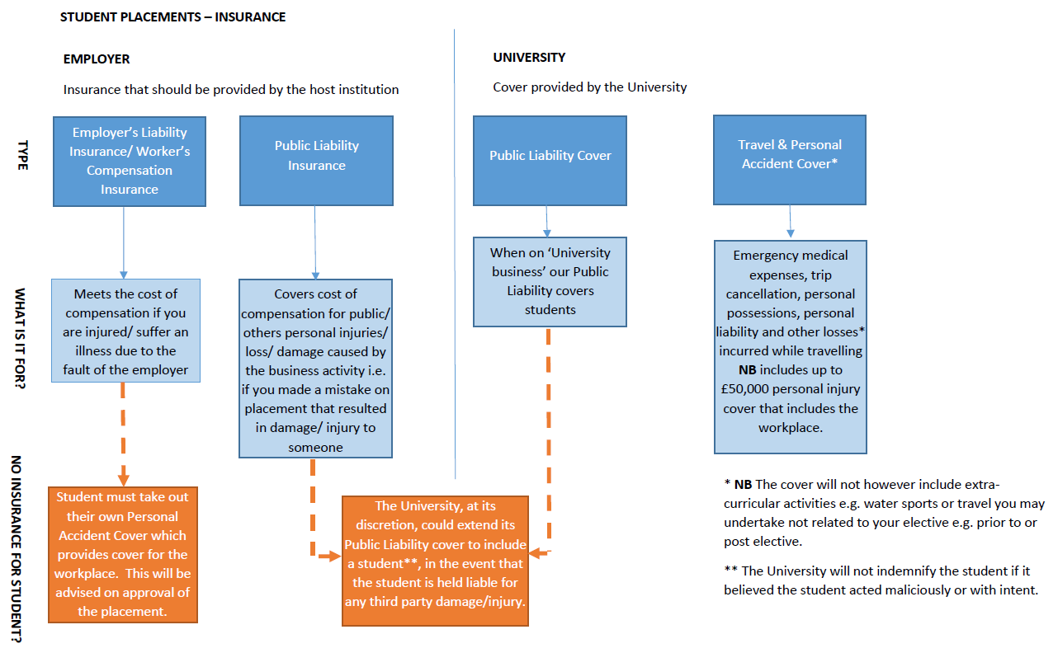

Slide 10
What you must do?
You will be advised if your placement does not provide ELI/ PLI or equivalent.
You must decide whether you are happy to proceed with the placement.
If you choose to proceed the University advise you to take out your own personal accident cover – to include workplace activities.
The level of cover you can buy is unlikely to be as comprehensive as a UK based ELI policy.
You must consider the level of cover required e.g. what would you need if you were to suffer a life changing injury.
The University is unable to advise on insurance as we are not part of the Financial Conduct Authority.

Slide 11

Questions?

